Slide 1


Slide 2

Dependency Injection

Slide 3

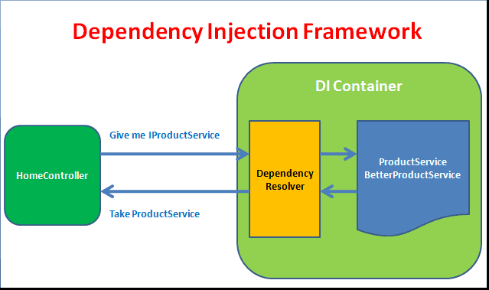
Introduction
Dependency Injection (DI) is a software design pattern that allows us to develop loosely coupled code. DI is a great way to reduce tight coupling between software components. DI also enables us to better manage future changes and other complexity in our software. The purpose of DI is to make code maintainable.

Slide 4
  Responsibility of dependency injection
Create the objects
Know which classes require those objects
And provide them all those objects

Slide 5
  Benefits of using DI
Helps in Unit testing.
Boiler plate code is reduced, as initializing of dependencies is done by the injector component.
Extending the application becomes easier.
Helps to enable loose coupling, which is important in application programming.

Slide 6
  Disadvantages of DI
It’s a bit complex to learn, and if overused can lead to management issues and other problems.
Many compile time errors are pushed to run-time.
Dependency injection frameworks are implemented with reflection or dynamic programming. This can hinder use of IDE automation, such as “find references”, “show call hierarchy” and safe refactoring.

Slide 7
  Types of dependency injection
Constructor Injection - The dependencies are provided through a class constructor. This is a widely used way to implement DI.
Property/Setter Injection - The client exposes a setter method that the injector uses to inject the dependency. Recommended using when a class has optional dependencies.
Method Injection - The dependency provides an injector method that will inject the dependency into any client passed to it. It could be useful, where the whole class does not need the dependency, only one method having that dependency. This is the way is rarely used.

Slide 8
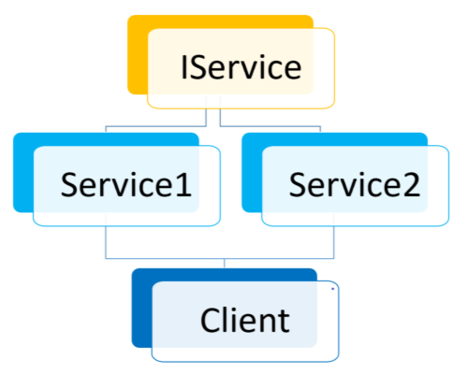
  Example

Slide 9
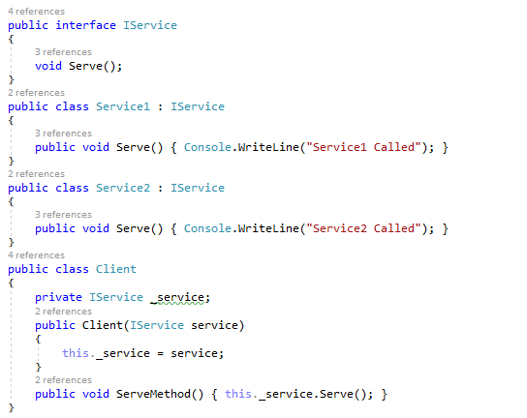
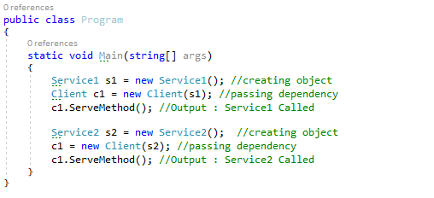
  Constructor Injection

Slide 10
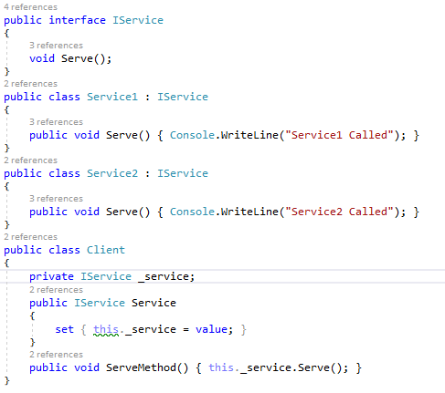
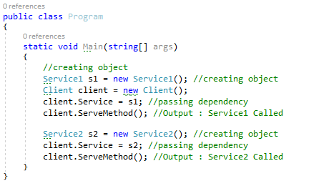
  Property/Setter Injection

Slide 11
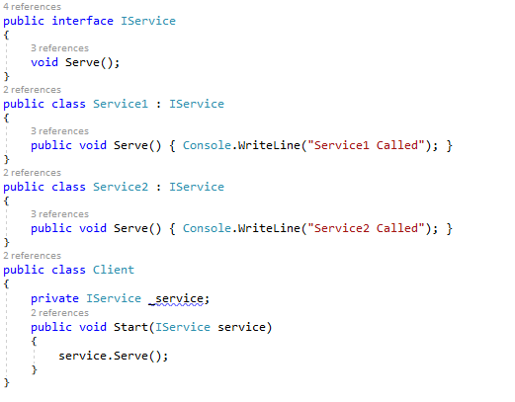
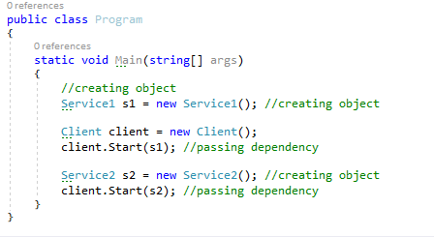
  Method Injection

Slide 12
  Libraries and Frameworks that implement DI
StructureMap
Unity
Castle Windsor

Slide 13
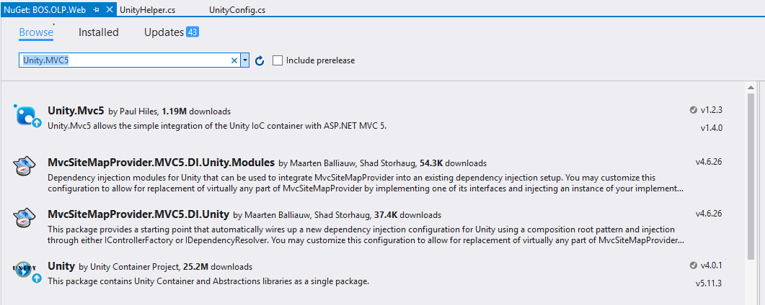
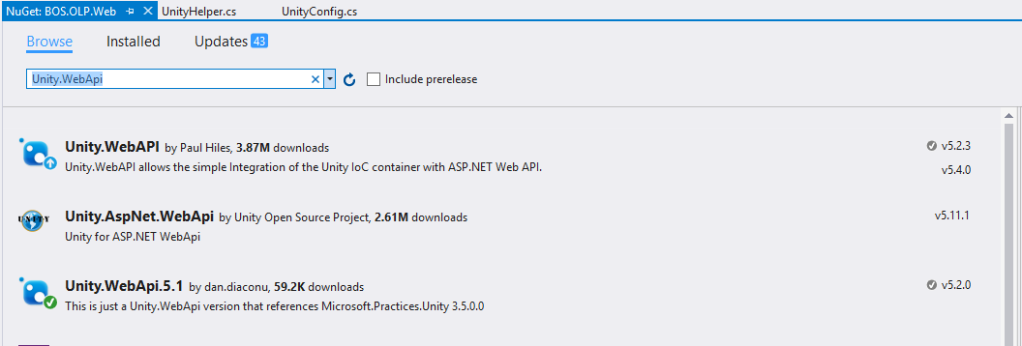
  Interface and Concrete class mapping using Unity.Mvc5 & Unity.WebApi

Slide 14
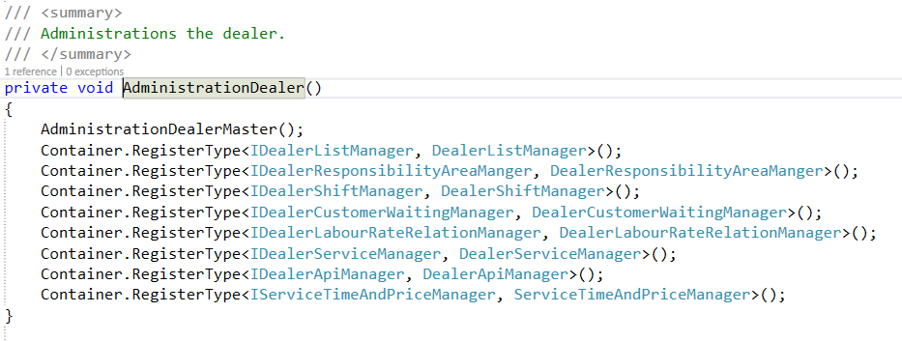
For e.g. IDealerListManager is the interface and mapped with class DealerListManager.

Slide 15
  Helper Method
public class UnityRepositoryHelper : UnityContainerExtension
{
protected override void Initialize()
{
Container.RegisterType<IRepository, Repository>();
}
}
container.AddNewExtension<UnityRepositoryHelper>();

Slide 16




THANK YOU
HEAD OFFICE:
B/81, Corporate House, Judges Bunglow Road,
Bodakdev, Ahmedabad - 380054. India.
+91 79 2685 2554 / 55 / 56
gateway@thegatewaycorp.com
WWW.THEGATEWAYCORP.COM

